Slide 1

1.STUDENT DETAIL
Name - HARI DARSHAN S.V.
SkillsBuild Email id - svharidarshan07@gmail.Com
AICTE Student Register Id - STU64a65c845811c1688624260
College Name - JSS Academy of Technical Education Bangalore
College Address & State - Dr.Vishnuvardhan Rd Uttarahalli-Kengeri Main Road, JSS Campus Rd, Srinivaspura, Bengaluru, Karnataka 560060.
Internship Domain - ARTIFICIAL INTELLIGENCE
Date - 18-August-2023 to 30-September-2023

Slide 2
2.PROJECT TOPIC
Sentimental Analysis Restaurant Review Prediction
Problem Statement:
In the age of digital media and online platforms, customer reviews play a crucial role in influencing people's choices, particularly when it comes to dining at restaurants. Understanding the sentiment behind restaurant reviews can provide valuable insights to both restaurant owners and potential customers. Therefore,
Project is to develop a sentiment analysis model for restaurant reviews that predicts whether a given review is positive or negative. To achieve this, we will use the Natural Language Toolkit (NLTK) library for text preprocessing and machine learning classification algorithms, including Multinomial Naive Bayes, Logistic Regression, and Support Vector Classification.

Slide 3
3.AGENDA
Project Planning and Preparation Gather and prepare the necessary resources, including data and tools.
Data Collection and Preprocessing Perform data cleaning to remove noise and irrelevant information from the text, such as special characters, HTML tags, or URLs.
Exploratory Data Analysis (EDA) Explore the dataset's statistics, including the distribution of sentiment labels. Visualize the data to gain insights into patterns and trends
Feature Extraction and Engineering Generate relevant features from the text data, such as bag-of-words, TF-IDF vectors, or word embeddings.
Model Selection and Training Choose a suitable sentiment analysis algorithm or model (e.g., logistic regression, Naive Bayes, SVC). Split the dataset into training, validation, and test sets. Train the chosen model using the training data and fine-tune hyperparameters using the validation set.
Result finding out accuracy score, classification report , confusion matrix and prediction for all ML classification algorithms.

Slide 4
4.PROJECT OVERVIEW
Scope: Initially, geographical area or cuisine but can expand to cover a broader range of restaurants The system will process text-based restaurant reviews and predict their sentiment as positive or negative.
Objectives: Sentiment Prediction, User-Friendly Interface, Real-Time Analysis, Continuous Improvement
Purpose: Enhance Customer Experience: By analyzing restaurant reviews, the system helps restaurant owners and managers understand customer sentiment. Positive feedback can reinforce what's working well, while negative feedback can pinpoint areas for improvement.
Automated Review Processing: Automating sentiment analysis saves time and resources that would otherwise be spent manually reading and categorizing reviews, especially when dealing with a large volume of feedback.
Feedback Loop: The system's feedback loop allows for continuous refinement. By incorporating user feedback and monitoring sentiment trends over time, the model can adapt to changing customer preferences and language patterns.
Business Growth: Improving the customer experience based on sentiment analysis can lead to increased customer loyalty, positive word-of-mouth, and ultimately, business growth for restaurants.
Scalability, Research and Insights, Data-Driven Decision Making.

Slide 5
5.Who Are The End Users
Restaurant Owners and Managers: The end users and target audiences for a sentiment analysis solution for restaurant reviews are diverse and include restaurant owners, customers, data analysts, researchers, application developers, industry consultants, and platform users. The solution provides benefits such as improved decision-making, enhanced customer experiences, research opportunities, and more informed dining choices, depending on the user group's needs and objectives.
Characteristics: Restaurant owners and managers are primarily interested in improving their establishments' performance. They may or may not have technical expertise but are keen on customer feedback.
Benefits:
Gain insights into customer sentiment to identify areas for improvement.
Make data-driven decisions to enhance the restaurant's offerings and service quality.
Monitor trends and adapt to changing customer preferences.
Improve customer satisfaction and loyalty.
Increase revenue through better management and customer service.

Slide 6
6.Solution And Value Proposition End user
Addressing the Needs of Restaurant Owners:
Data-Driven Decision Making
Competitive Advantage
Informed Dining Decisions
Filtered and Relevant Information
Confidence Building
Highlight how our solution bridges the gap between restaurant owners and potential diners.
Stress the mutual benefits of enhanced dining experiences and improved restaurant reputations.
Encourage the adoption of our sentiment analysis tool to create a win-win scenario for all stakeholders in the restaurant industry.

Slide 7
7.Customization Made For Project
Customization Made:
Made Accuracy Score vs. Hyperparameter Alpha Value Graph
Hyperparameter Tuning for Logistic Regression
Hyperparameter Tuning for Support Vector Classification (SVC)
Applied ML supervised classification algorithm found Classification Report, Accuracy score, confusion matrix for all model.
EDA data cleaning and preprocessing.
Predict sentence Individually or set positive or negative using NLTK library and ML supervised classification algorithm.
Improved Model Performance

Slide 8
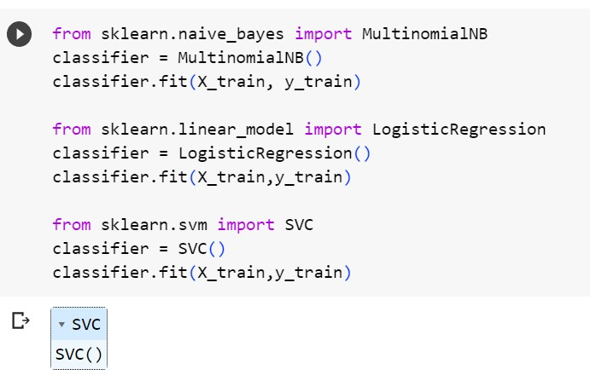
8.Modelling
Training and Testing supervised classification algorithm model 0.21 test size used Multinomial Navie bayes, Logistic regression and Support vector classification to predict accuracy score and classification report and confusion matrix to predict the model quality predict sentimental analysis restaurant review.
Hyperparameters tunning finding the optimal values for the hyperparameters of a machine learning algorithm to achieve the best possible model performance.
Multinomial Navie Bayes-Accuracy score – 76%
Support vector classification- Accuracy score – 73%
Logistic Regression-Accuracy score – 71%

Slide 9
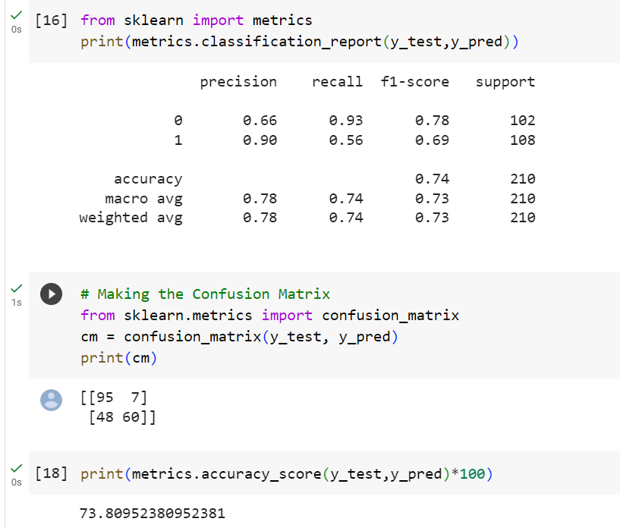
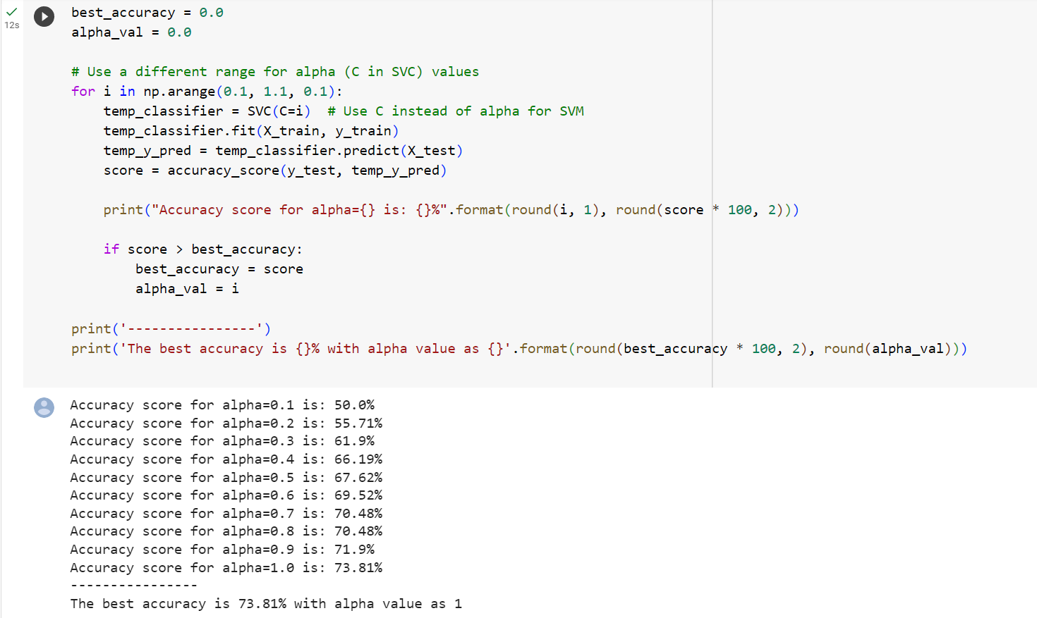
0
9.Result: Support Vector Classification Hyperparameter tuning : best accuracy score is 73.81% as alpha 1
Confusion matrix- [95 7]
[48 60]
Classification report- Precision 0.66,0.90,
Recall-0.93,0.56
Accuracy score- 73.809%

Slide 10
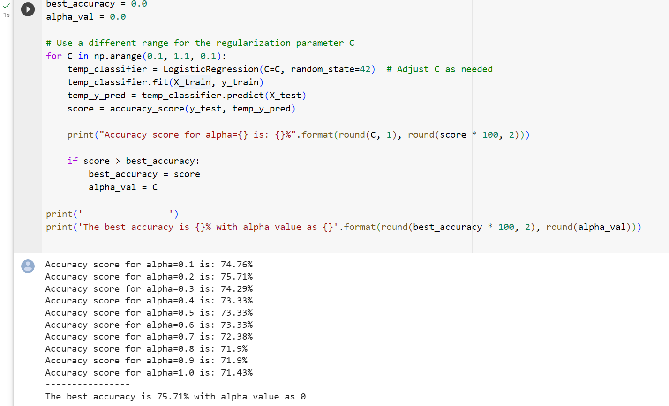
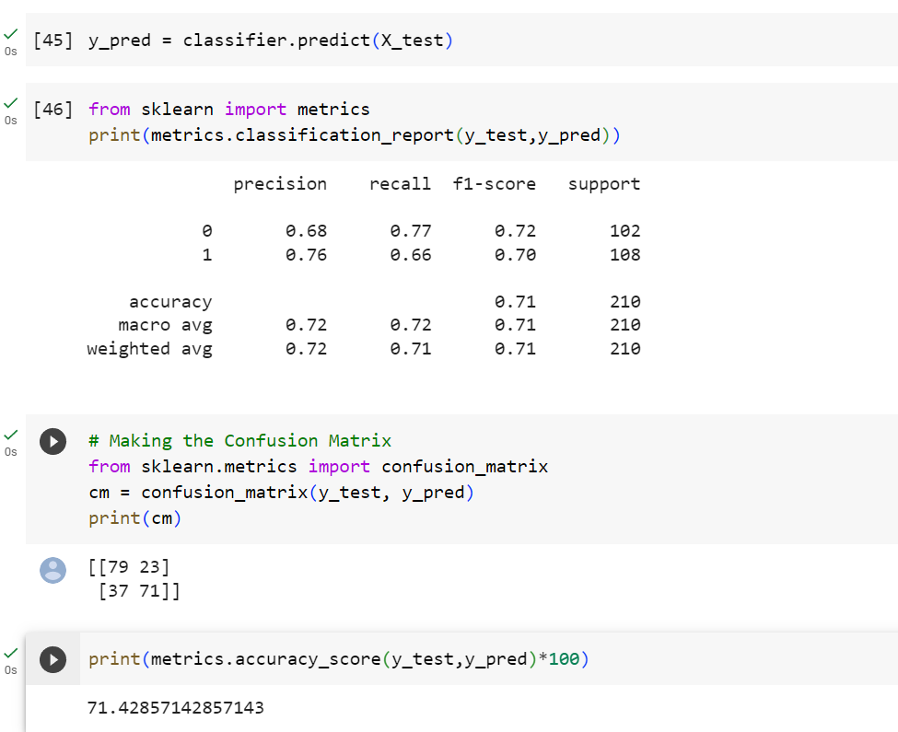
9.Result: Logistic Regression Hyperparameter tuning : best accuracy score is 75.71% as alpha 0
Confusion matrix- [79 23]
[37 71]
Classification report- Precision 0.68,0.76,
Recall-0.77, 0.66
Accuracy score- 71.428%

Slide 11
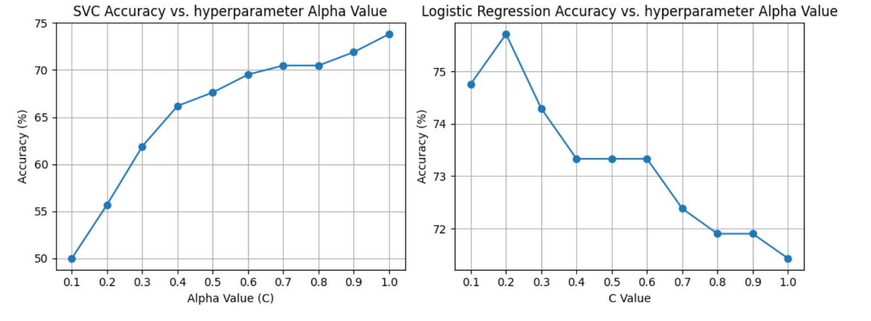
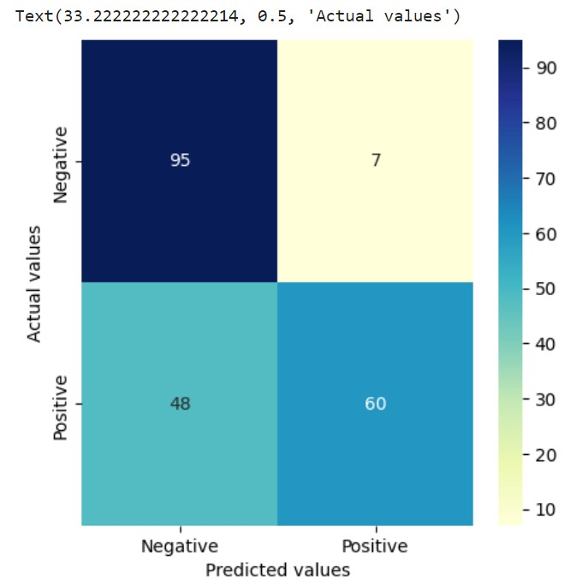
Graph SVC accuracy vs hyperparameter alpha value
Graph Logistic regression accuracy vs hyperparameter alpha value
Confusion matrix graph for svc.

Slide 12
10.Links
GitHub-LINK for code
Linkdin-LINK

